Slide 1

Insert Photo
தமிழ் தாய் வாழ்த்து
Notes:
Image not found. ImageFile=''. Also tried from SlideName='தமிழ் தாய் வாழ்த்து'. Searched in: ['/Users/AB74296/Downloads/DK PPT', '/Users/AB74296/Downloads/DK PPT/images', '/Users/AB74296/Downloads/DK PPT/imgs', '/Users/AB74296/Downloads/DK PPT/photos']

Slide 2
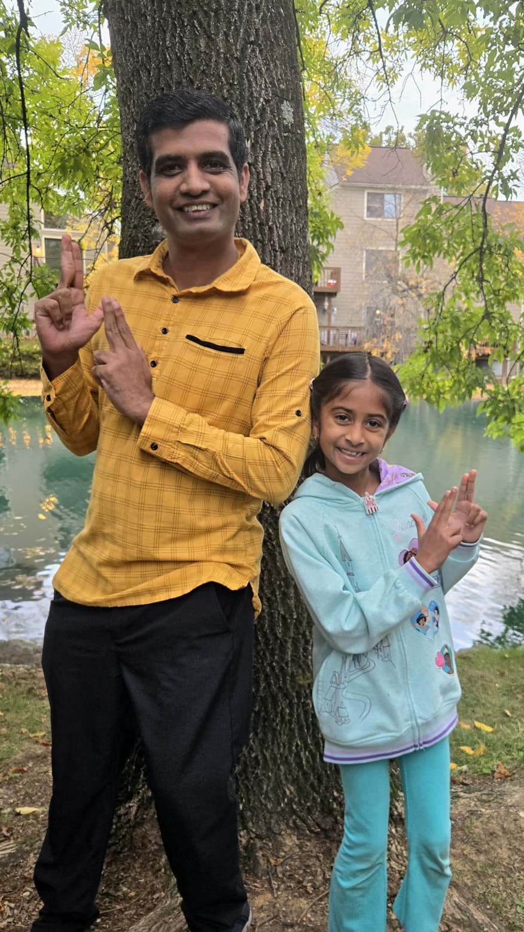
Adhya Ajith
Ajith Anand
DK39
Notes:
Image: DK39.jpeg

Slide 3
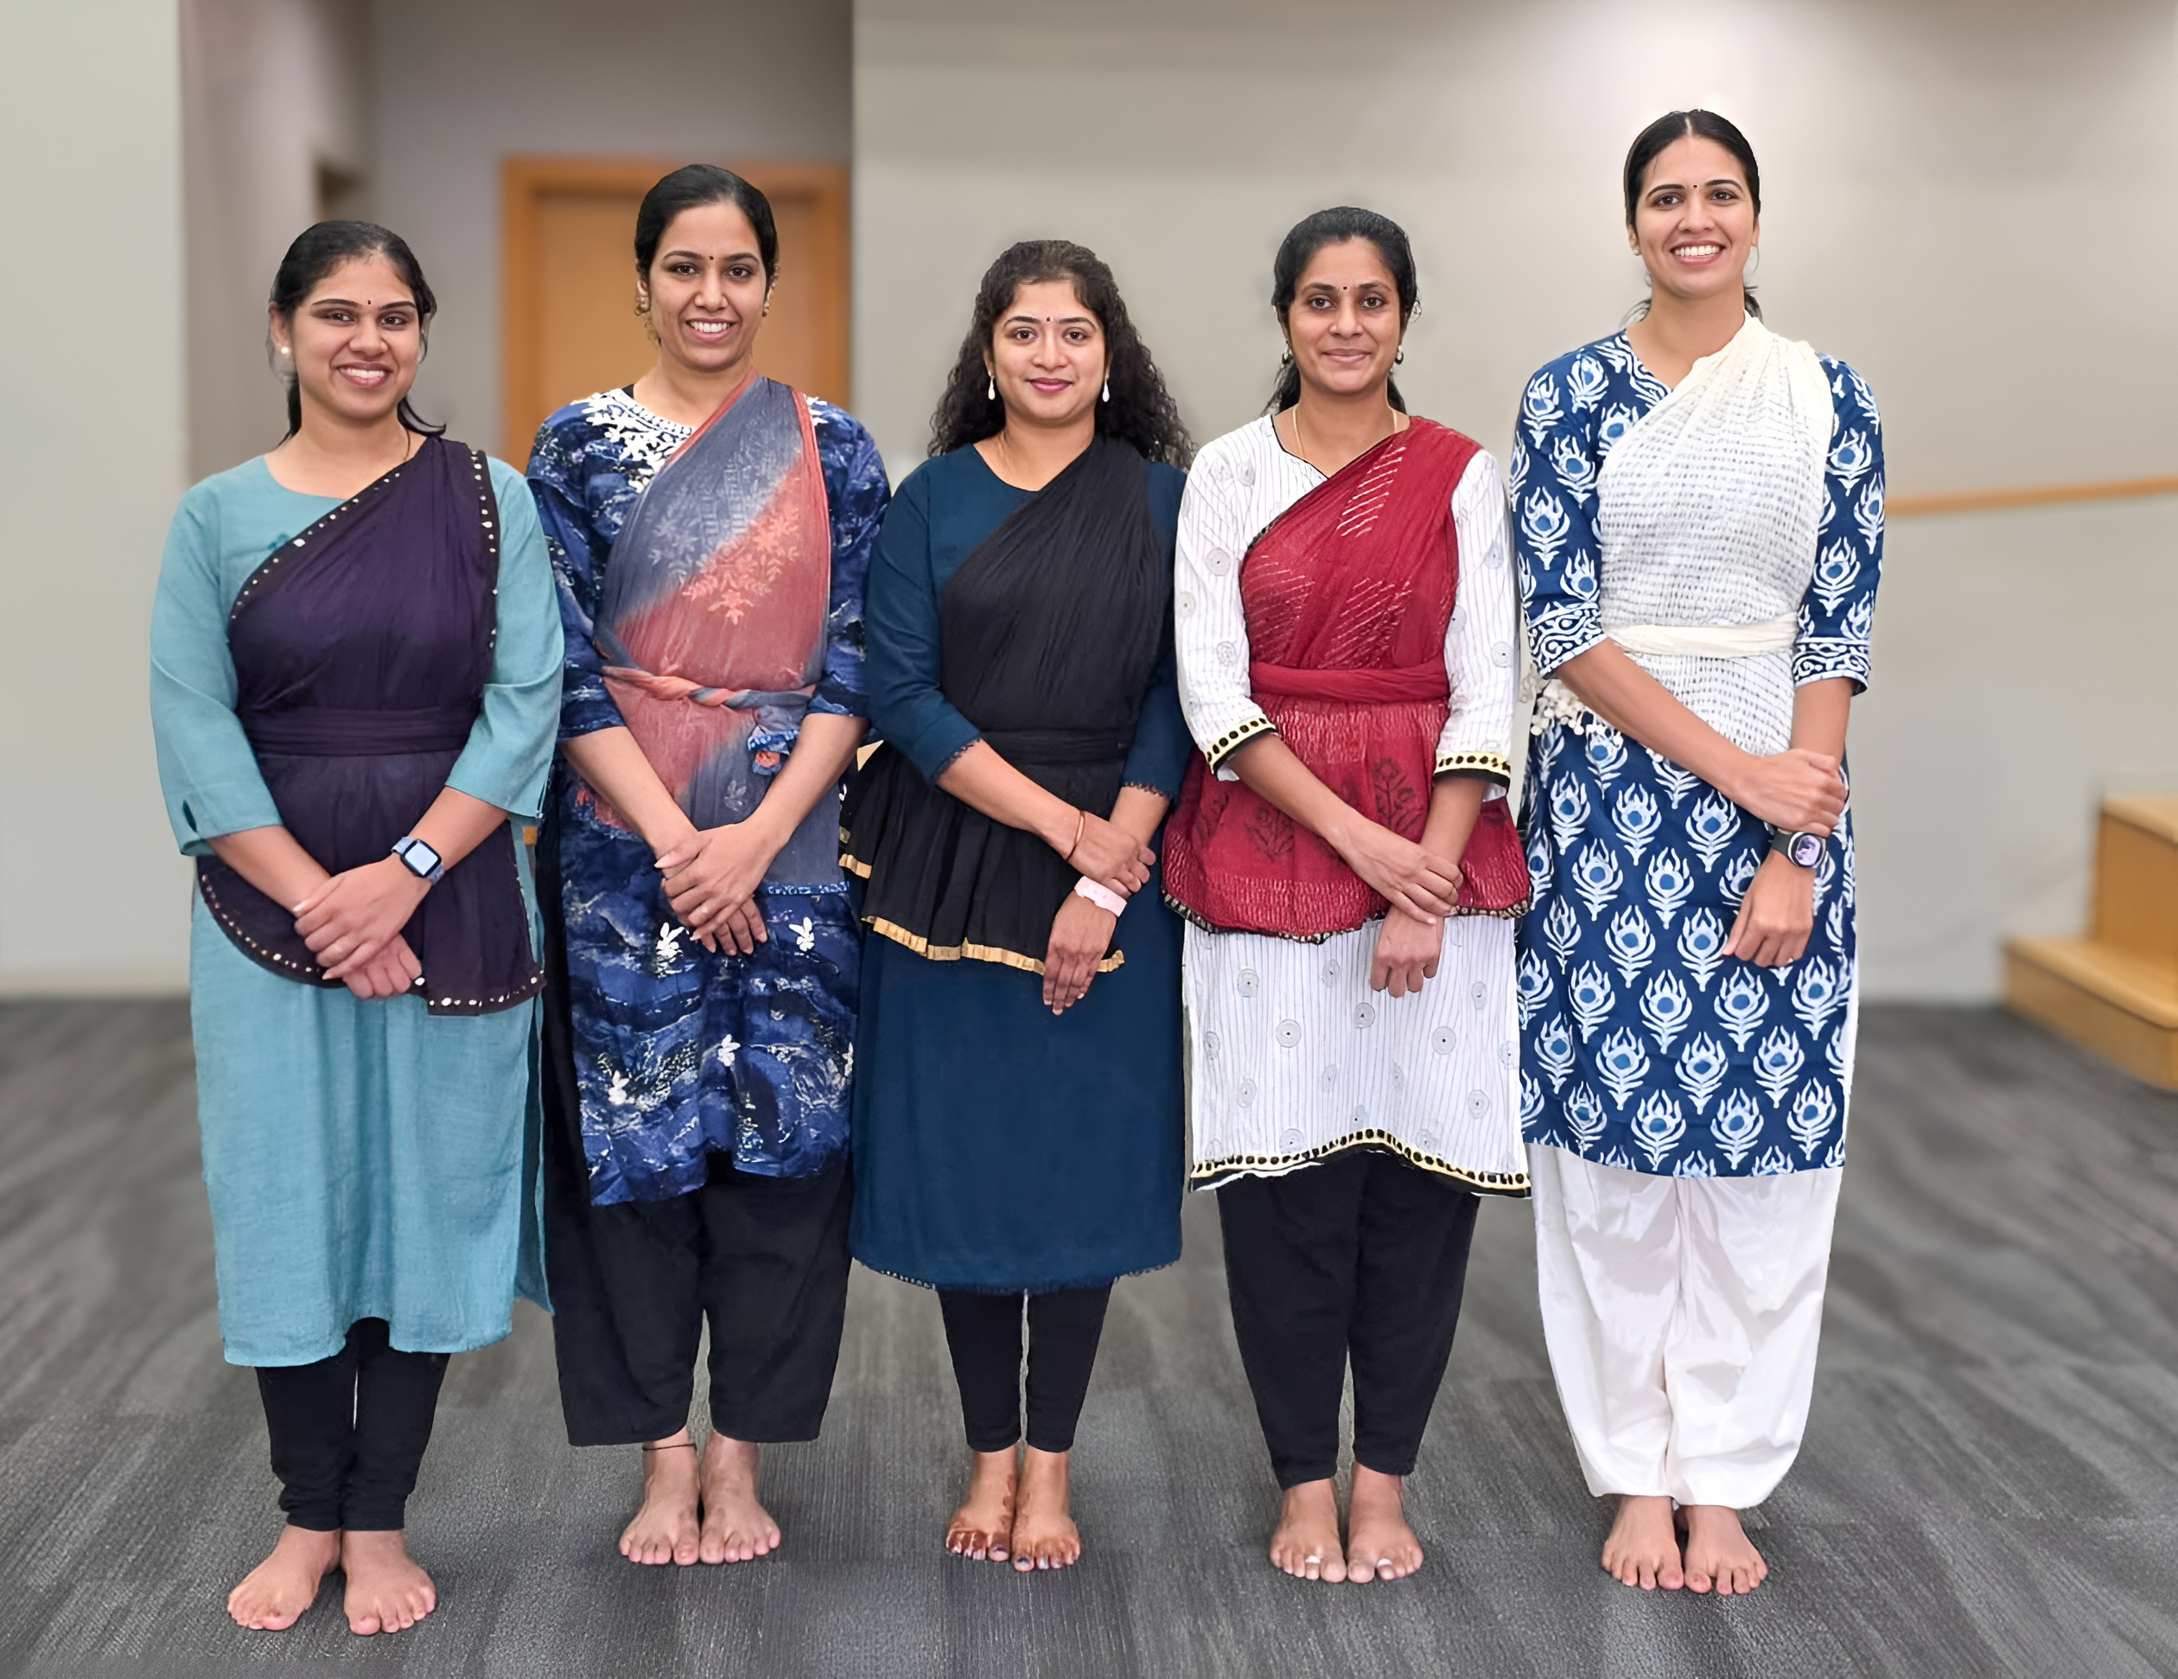
Anjana Rajeev Sandhiya Ramarajan Soumya Nair
Susmi Vysakham Uma Nandhini
DK08
Notes:
Image: DK08.jpg

Slide 4
Insert Photo
GCTS Tamil School
Notes:
Image not found. ImageFile=''. Also tried from SlideName='GCTS Tamil School'. Searched in: ['/Users/AB74296/Downloads/DK PPT', '/Users/AB74296/Downloads/DK PPT/images', '/Users/AB74296/Downloads/DK PPT/imgs', '/Users/AB74296/Downloads/DK PPT/photos']

Slide 5
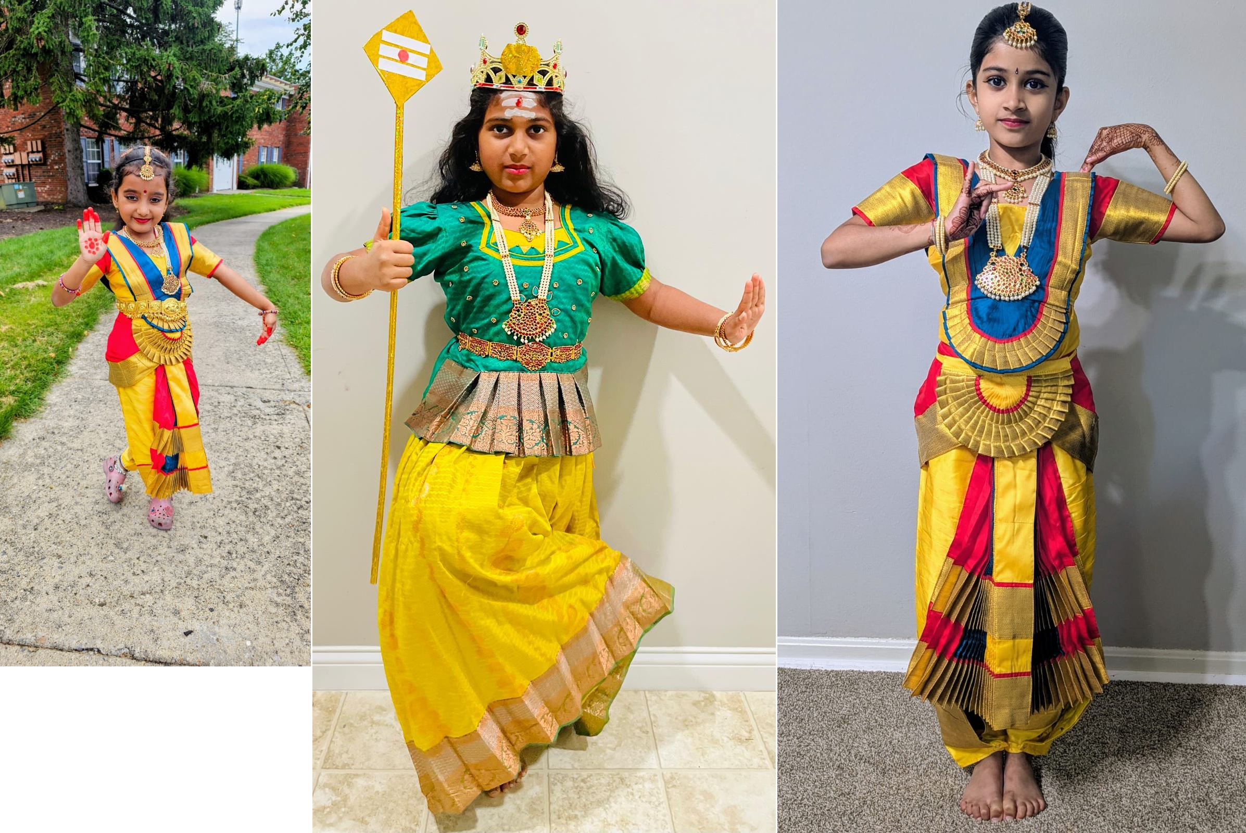
Anaya Kinge Maya Tesla
Neha Arul Muthu Sri Himaya Nallagonda
DK36
Notes:
Image: DK36.JPG

Slide 6
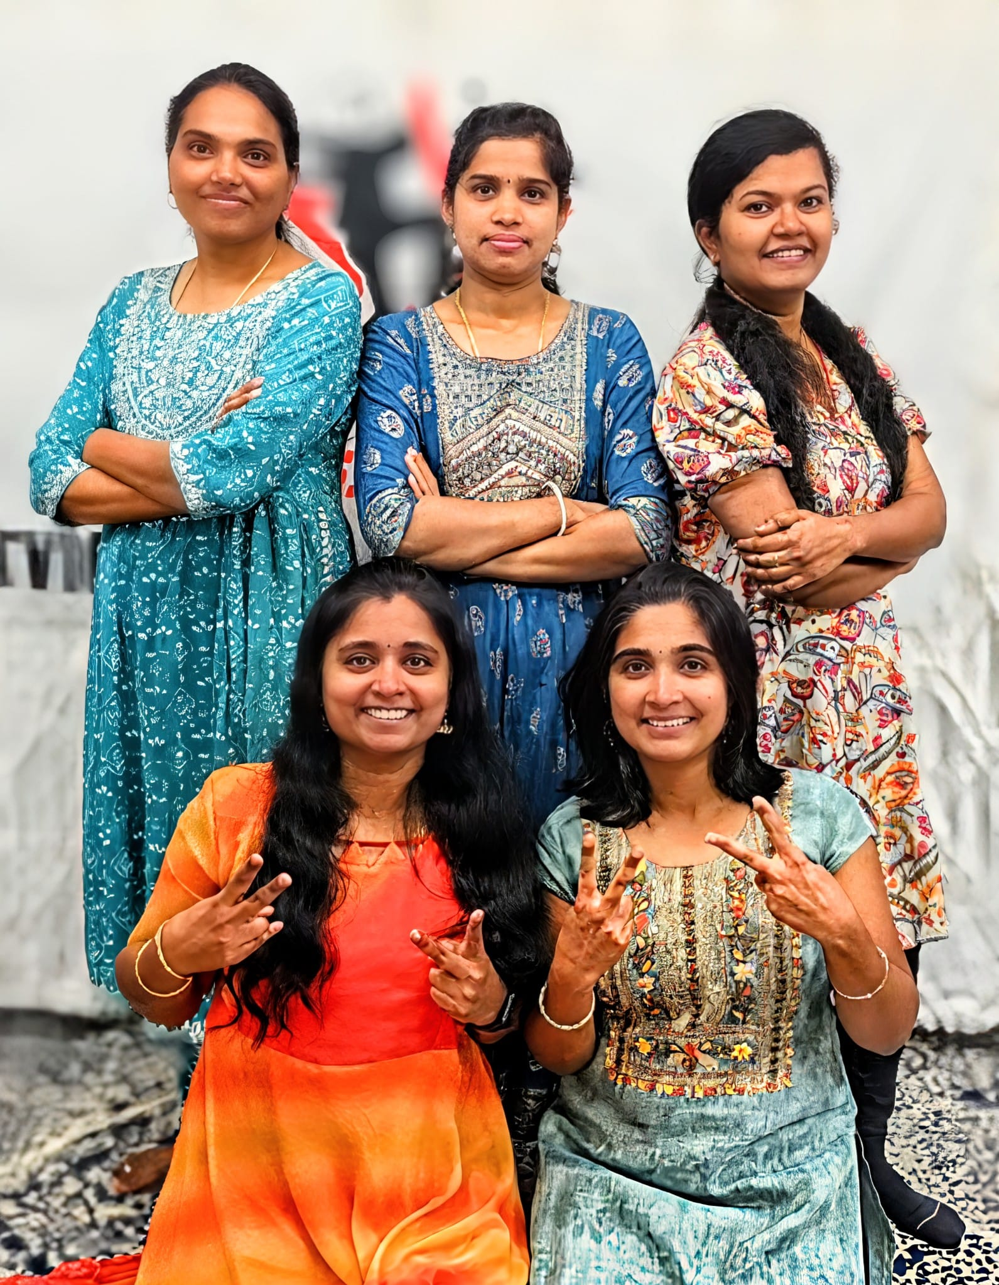
Deepika Karthick Gayathri Manoharan Jeo Phoebe Saranya Sivanandha
Shilpa Donthi Swathi Kamisetty Umabharathi Rajamari
DK27
Notes:
Image: DK27.jpg

Slide 7
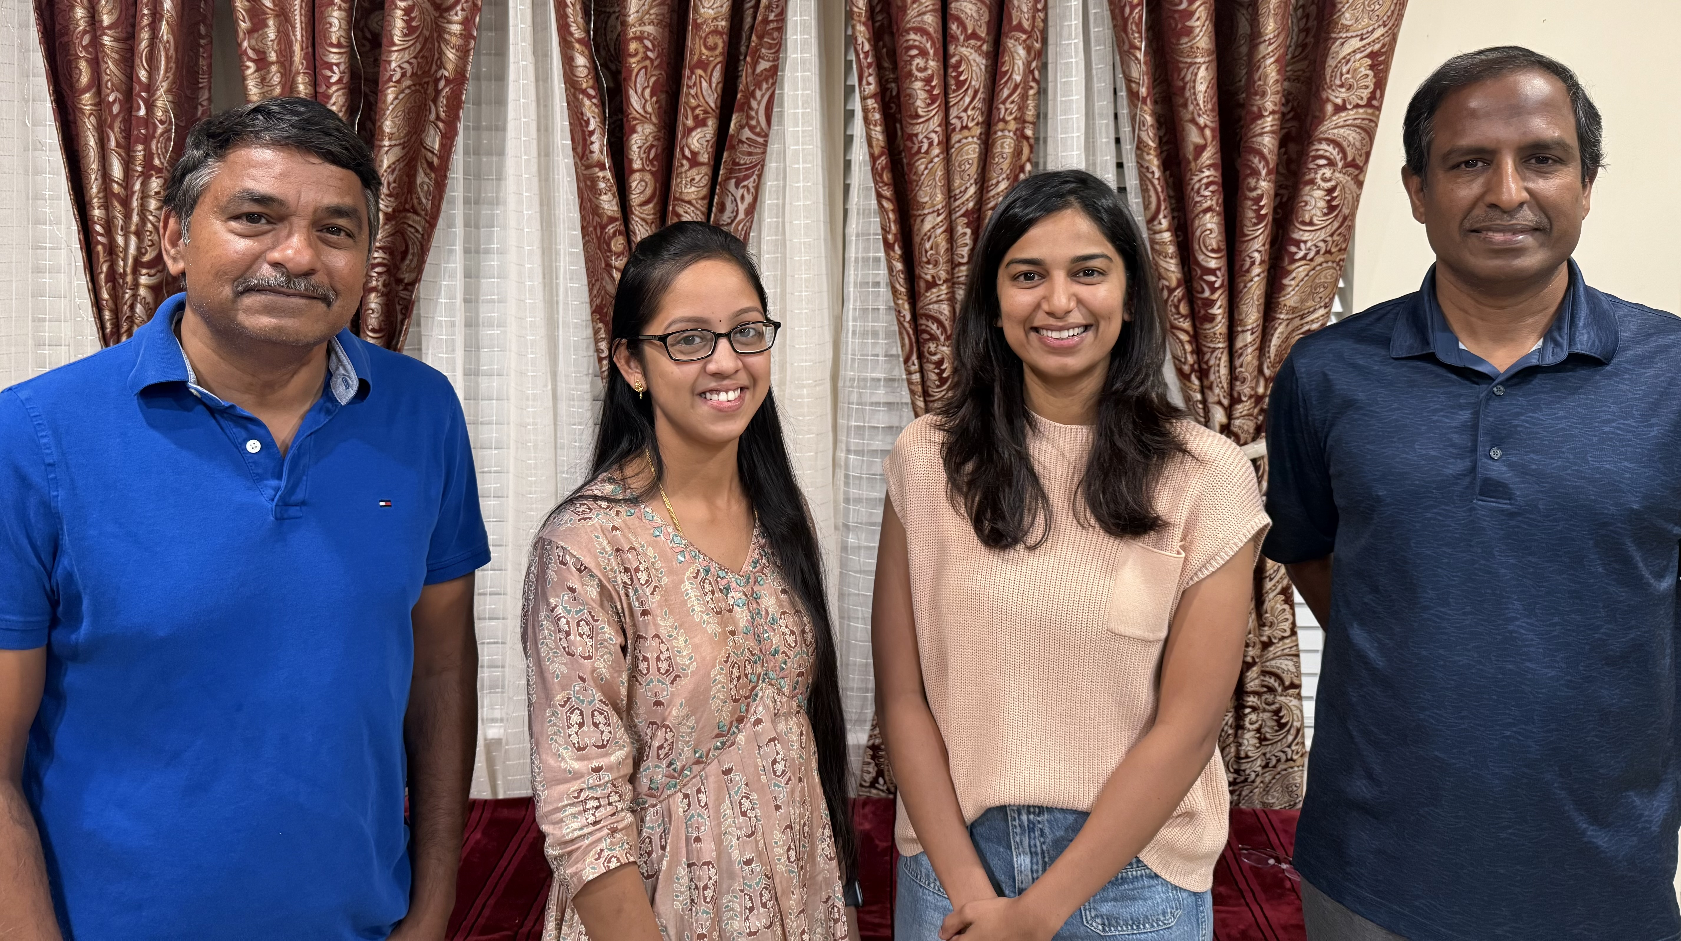
B Kalaiyarasan Chandrasekaran Thirumalaisamy
Gayathri Devaraj Vaishu Karthik
DK21
Notes:
Image: DK21.jpg (converted)

Slide 8
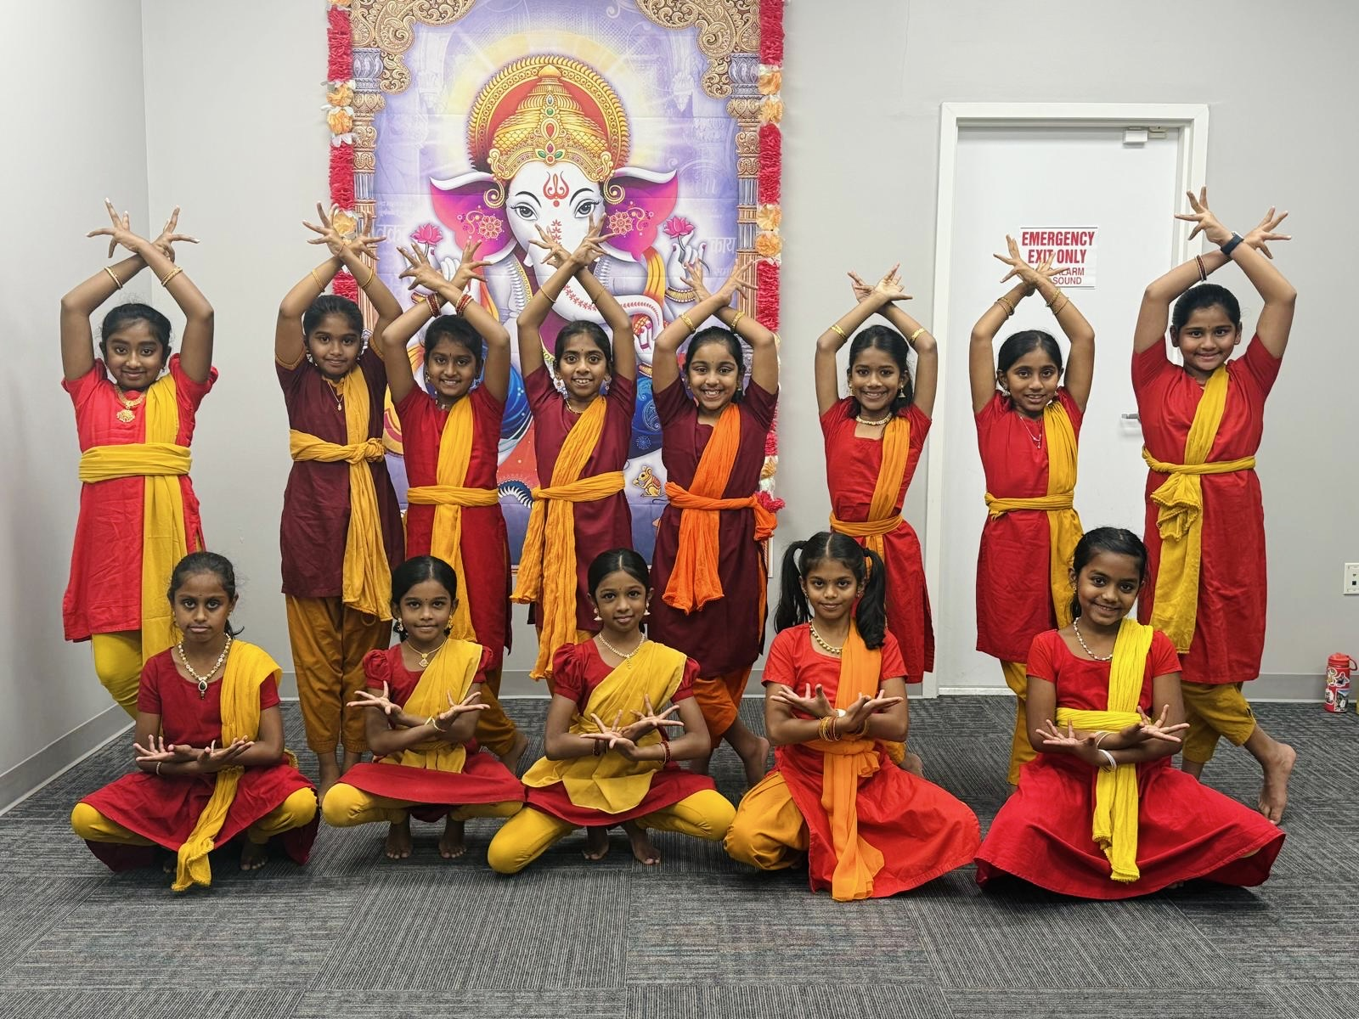
Advitha Prabu Dhanvi Vinothkumar Jananya NaveenKumar Krithi Sana Sudharsan Lalitha Sridhar Meera Raut Mridhu Laya Sudharsan
Nandini Patange Pavitra Menon Pramiti Nair Thanumitha Suresh Thusharasri Rajesh Trishika Velmurugan
DK02
Notes:
Image: DK02.jpg

Slide 9
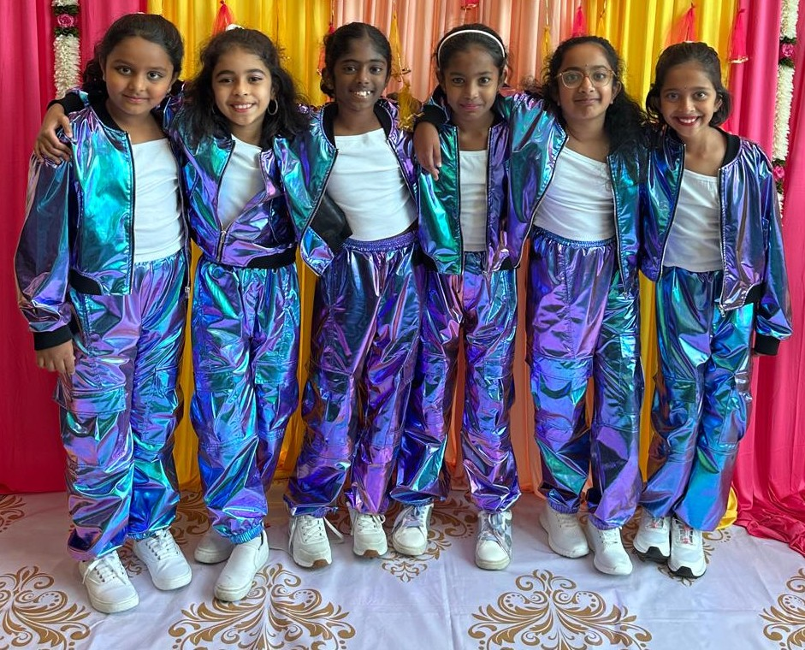
Adhira Vijaya Kumar Alagu Meenal Diya Nachammai Ramu Prakash
Diya Venkatraman Jagatjanani Mena Shivani Saranraj
DK23
Notes:
Image: DK23 .jpeg

Slide 10
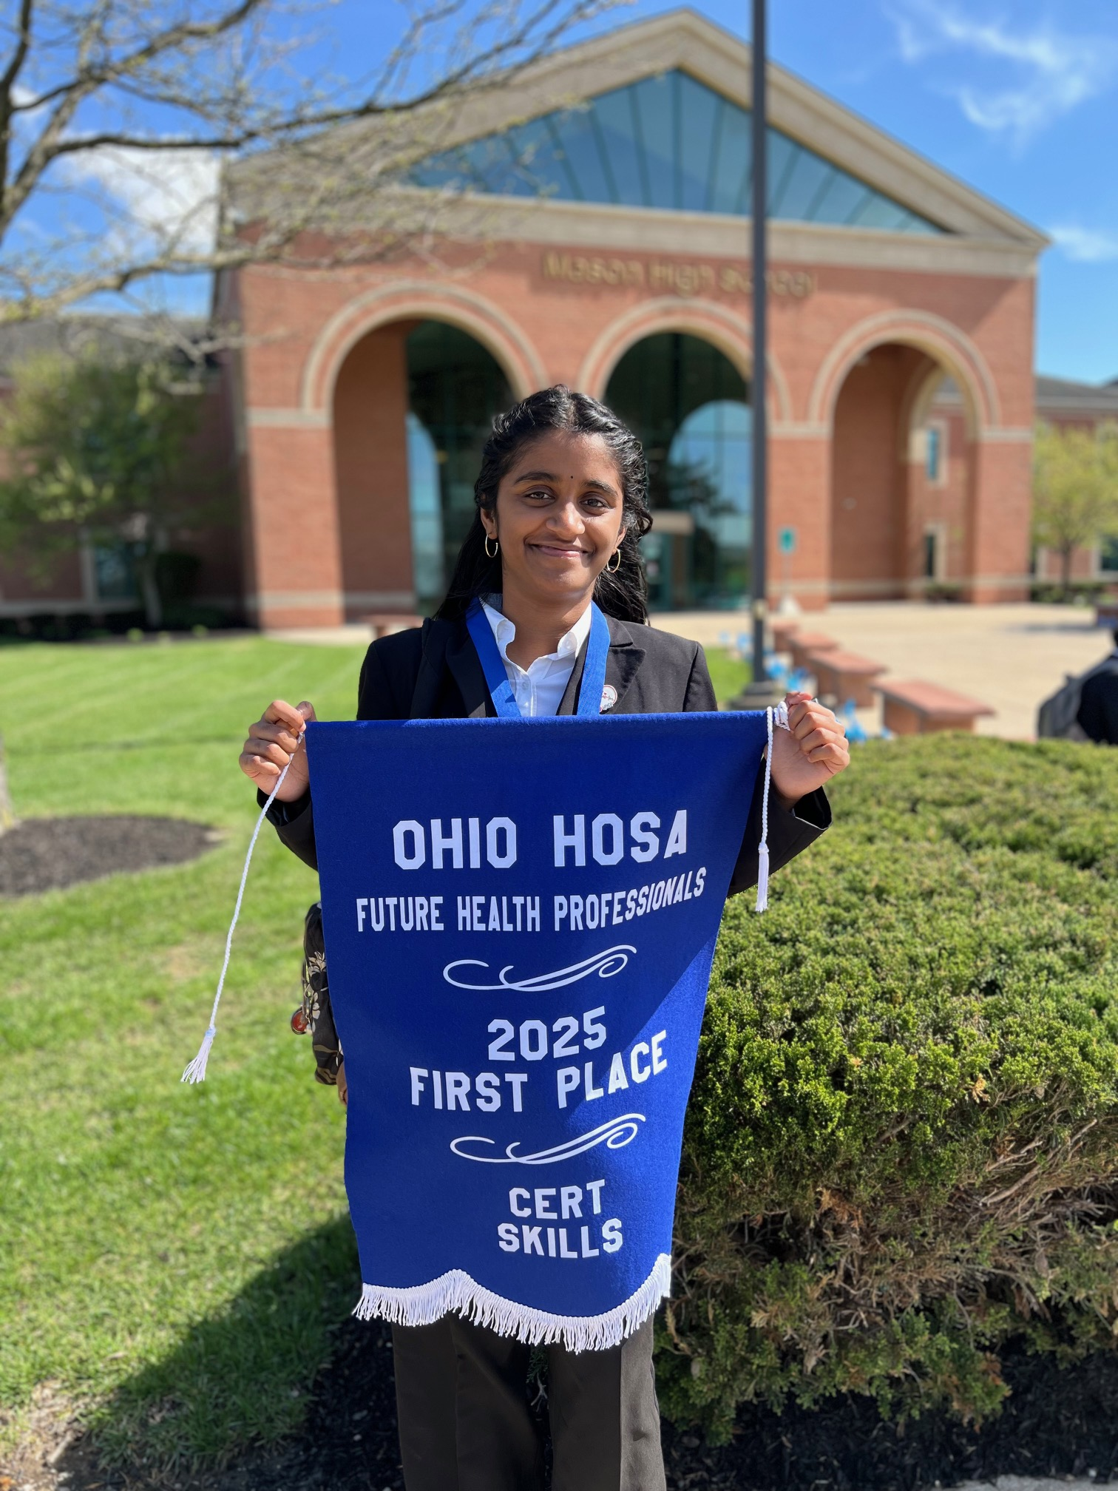
Annaya
DK40
Notes:
Image: DK40.jpeg

Slide 11
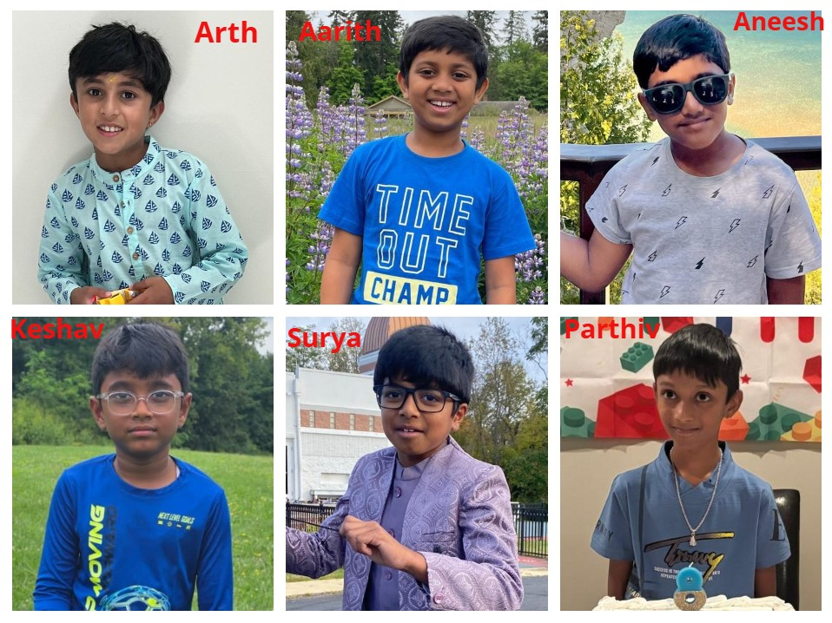
Adhav Chockalingam Ramu Prakash Aarith Adaikalam Arth Nair
Keshav Vasudev Ramanujam Paarthiv Arunkumar Surya Senthilkumar
DK14
Notes:
Image: DK14.jpg

Slide 12
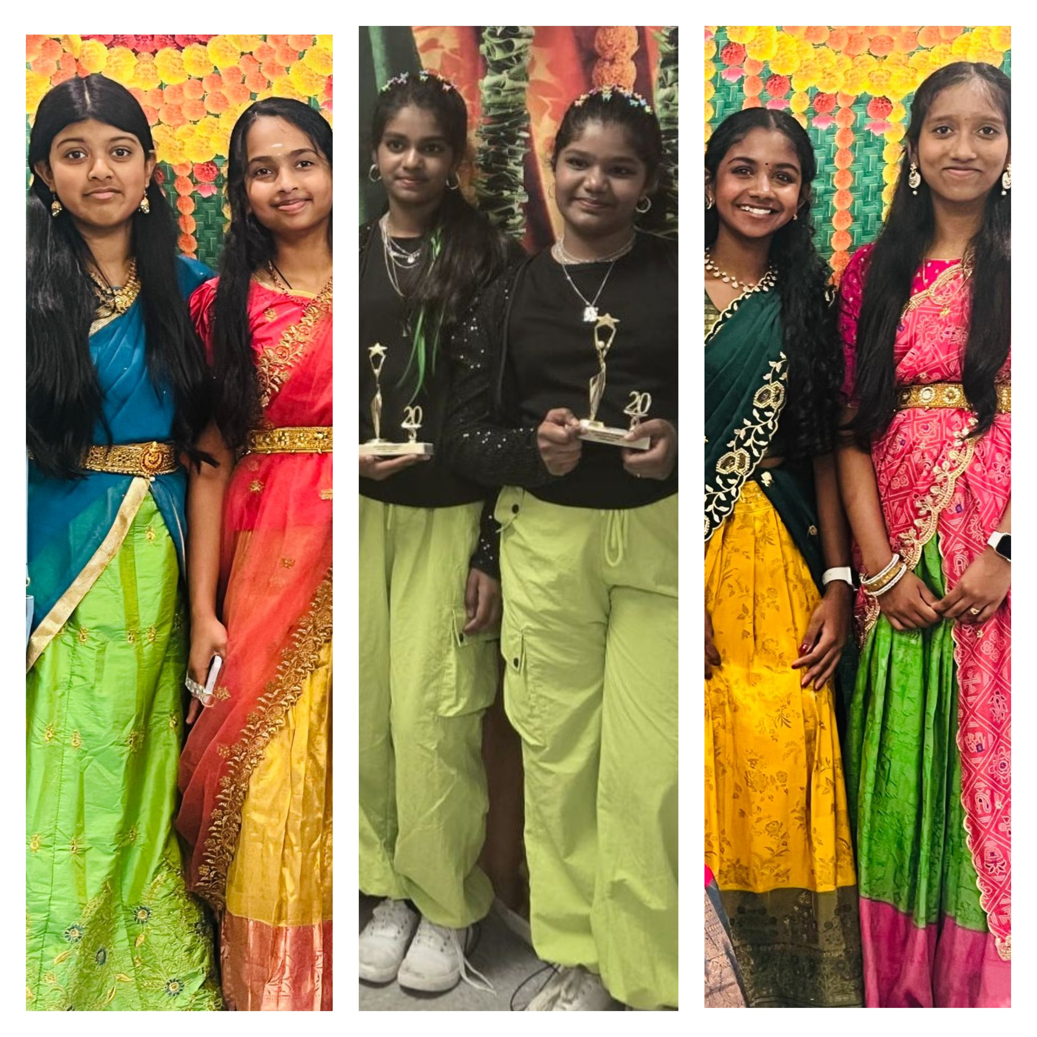
Jerrusha Richard Joanna John Mithra Manoranjitham Gajendran
Sharan Selisaa Antony Sezhain Srinisha Ezhilarasu Thanishka Ganeshkumar
DK19
Notes:
Image: DK19.jpg

Slide 13
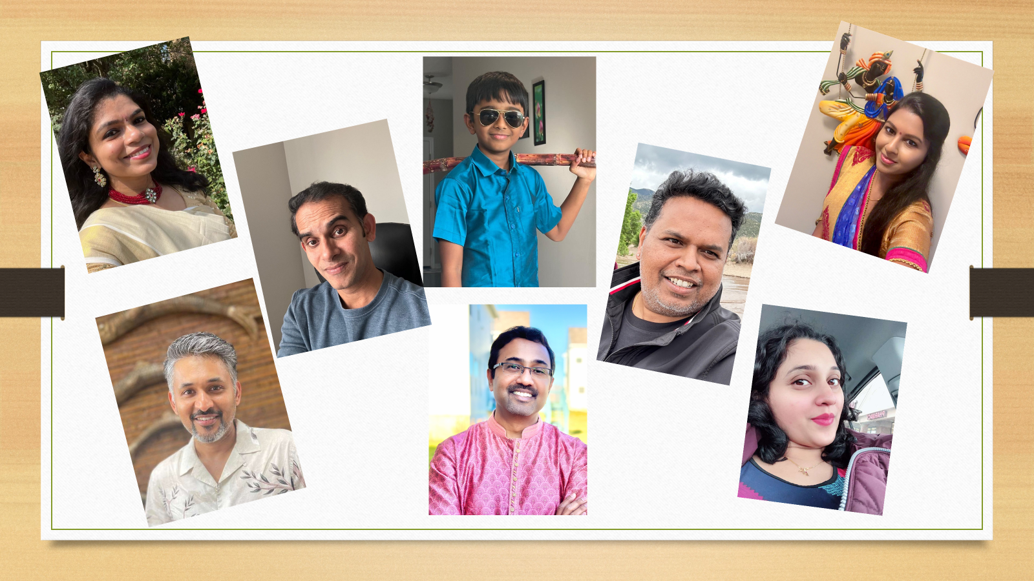
Janani Karthikeyan Govindaswamy Prabha
Sridhar Sruthi Vinodh Vinodh Venu
DK35
Notes:
Image not found. ImageFile=''. Also tried from SlideName='DK35'. Searched in: ['/Users/AB74296/Downloads/DK PPT', '/Users/AB74296/Downloads/DK PPT/images', '/Users/AB74296/Downloads/DK PPT/imgs', '/Users/AB74296/Downloads/DK PPT/photos']

Slide 14
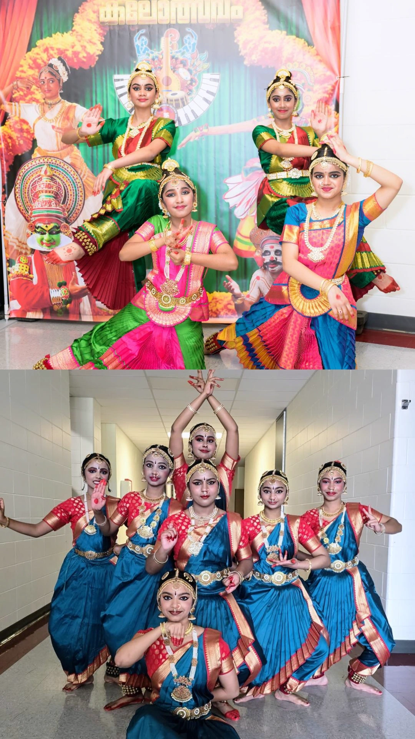
Amegha Sreeparvathy Siji Anugraha Sreeparvathy Siji Caitlyn Palayoor Devinanda Jyothish Kaimal Nandini Premjith
Niharika Deepak Rhea George Shreeya Kamal Shriya Gidhesh Shivani S Nair
DK42
Notes:
Image not found. ImageFile=''. Also tried from SlideName='DK42'. Searched in: ['/Users/AB74296/Downloads/DK PPT', '/Users/AB74296/Downloads/DK PPT/images', '/Users/AB74296/Downloads/DK PPT/imgs', '/Users/AB74296/Downloads/DK PPT/photos']

Slide 15
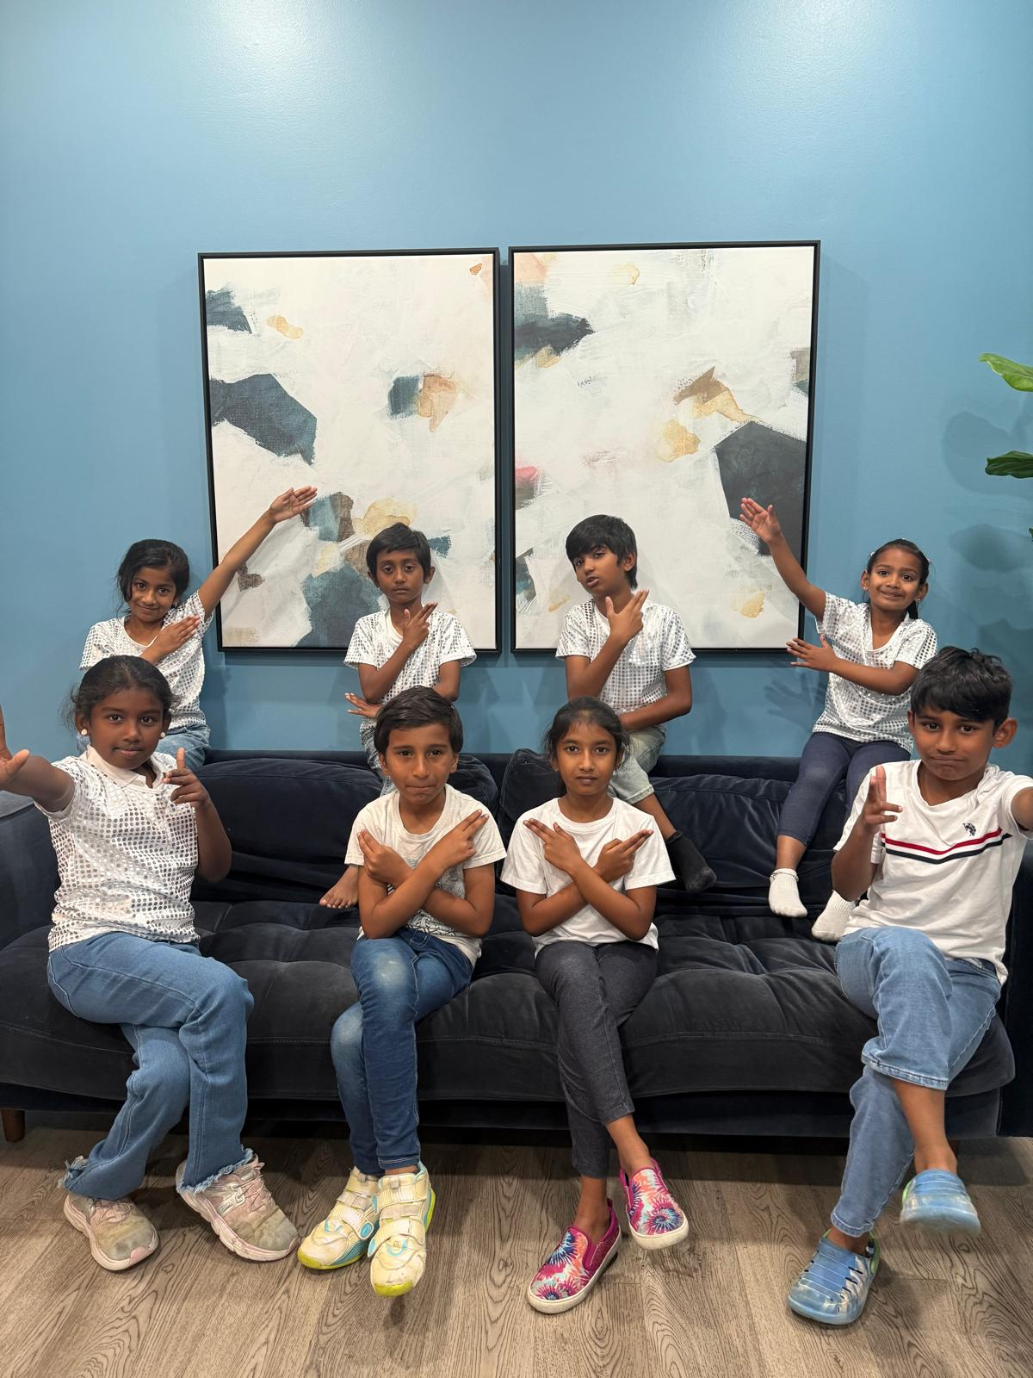
Arovizha Raju Diyaanigka Sivakumar Harshiv Ram Ballamurugan Kayal Prabhakaran Mahathi Bharath
Nethan Chandrasekar Rutvik Nainegali Saadurya Sankar Sanithkumaar Vijayakanth
DK28
Notes:
Image: DK28.jpg

Slide 16
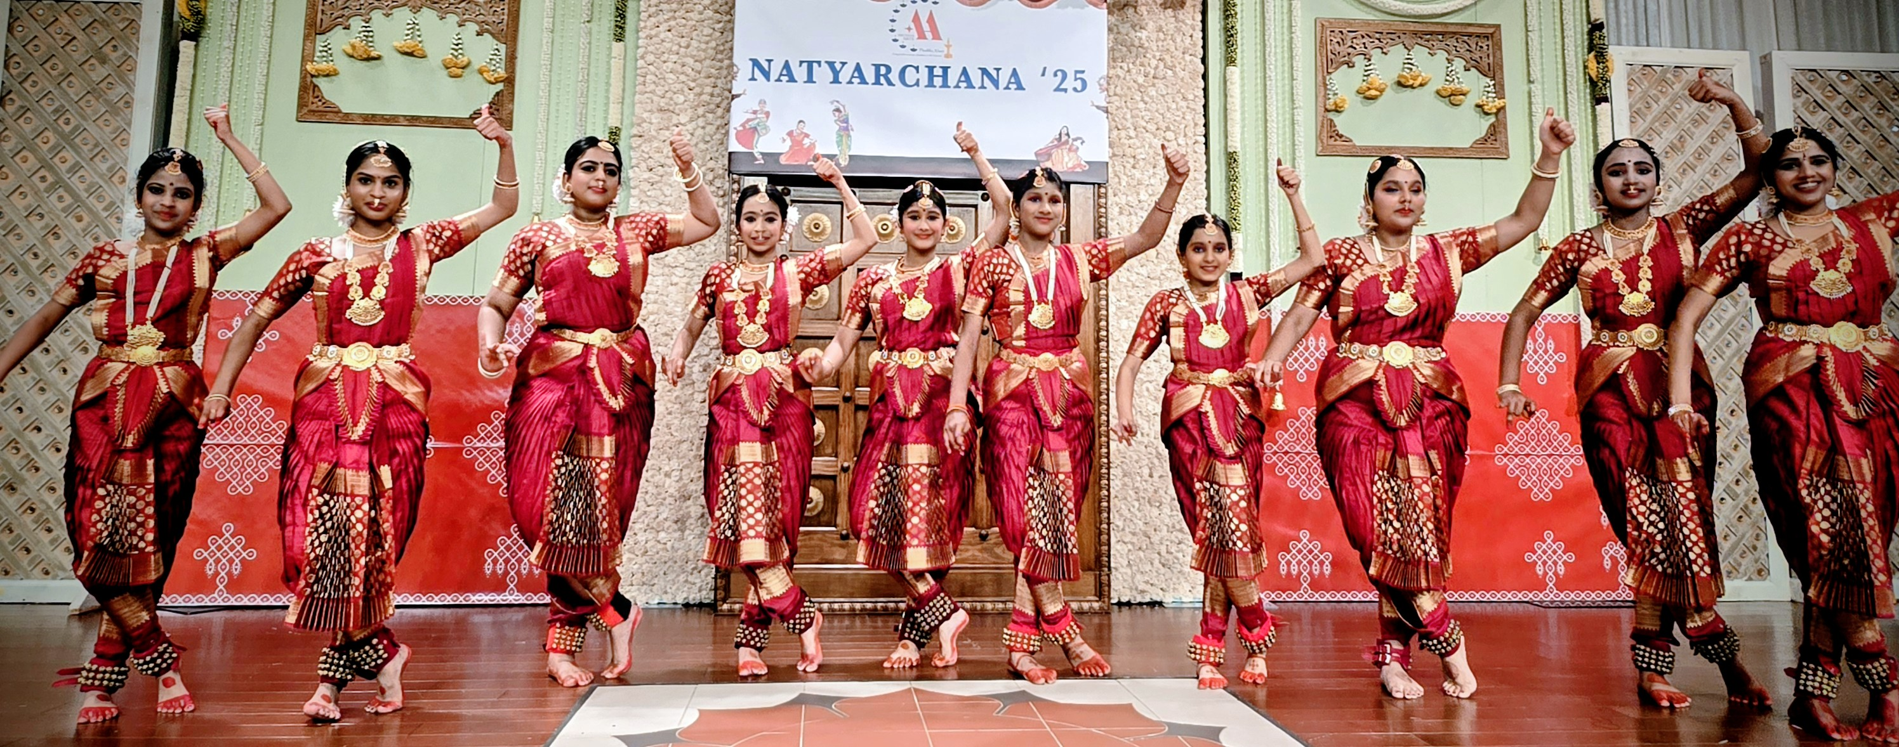
Aadhya Battepati Aneesha Reena Harinee Arasu Maya Dhinu
Medha Shinde Sahasra Patchigolla Sri Alaya Nallagonda
DK26
Notes:
Image: DK26.jpg

Slide 17
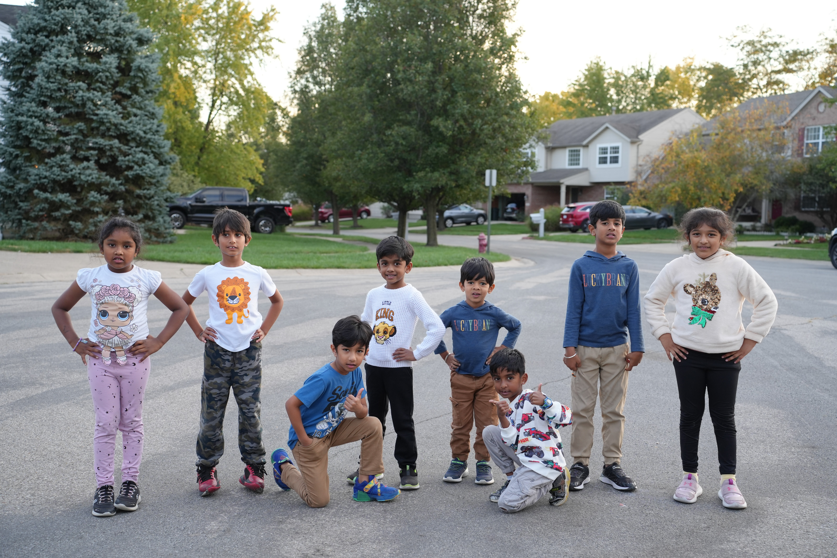
Aadhvik Navinchandar Adrithi Prabhu Ahaana Asvinchandar Athirayan Mohan Krithik Mohankumar
Nilan Vinoth Ravan Arun Revanth Vijayanadh Vedanth Vinoth
DK09
Notes:
Image: DK09.JPG

